Slide 1
ARM
Registers
Department of Computer Science and Engineering
Amrita School of Engineering
Coimbatore
ARM Registers
1
Notes:
1

Slide 2
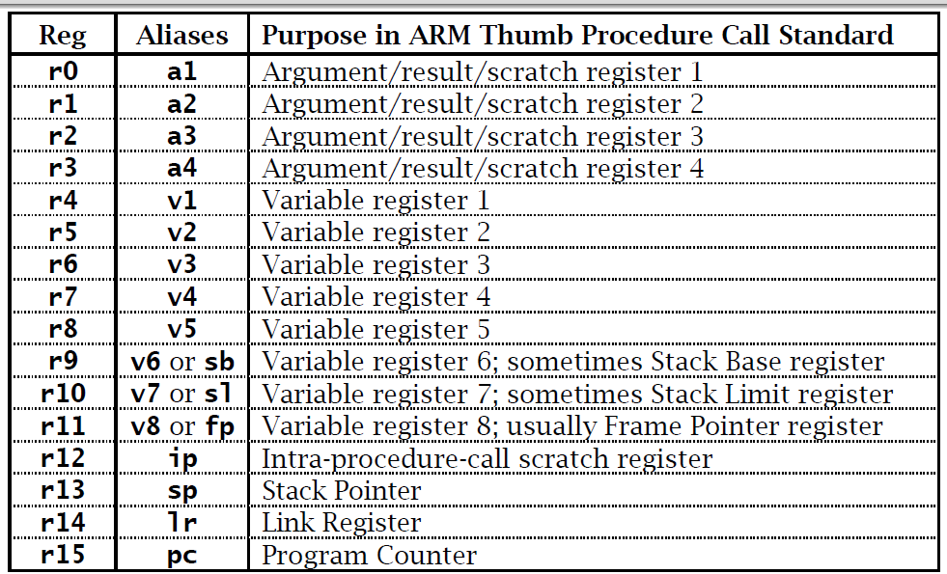
Register Names and Aliases

Slide 3
Special Registers
R13 – Stack Pointer
R14 – Link Register
R15 – Program Counter
ARM Architecture
3

Slide 4
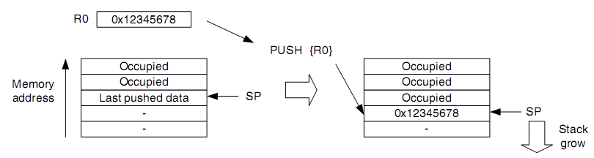
R13 – Stack Pointer
Stack Pointer points to Top of Stack
Main
Main
Function
ARM Architecture
4

Slide 5
R14 – Link Register
Link Register stores the Return Address
Main
Main
Function
ARM Architecture
5

Slide 6
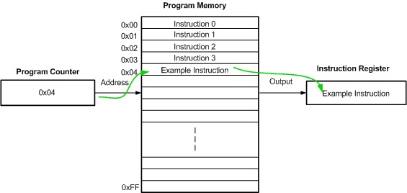
R15 – Program Counter
Program Counter points to next Instruction that is to be
Executed by the Processor
ARM Architecture
6

Slide 7
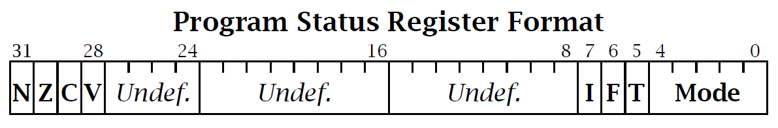
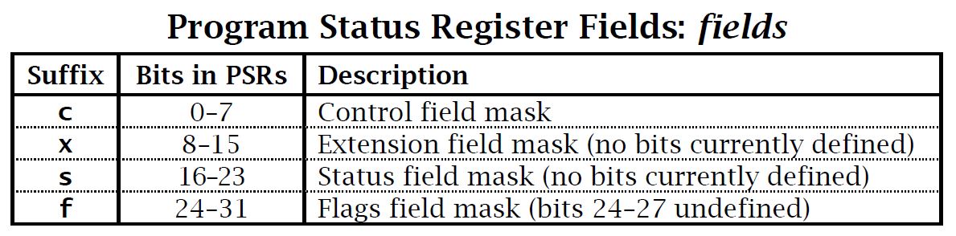

Slide 8
Program Status Register
CPSR : Monitors & Control Internal Operations
31
28
27
24
23
16
15
8
7
6
5
4
0
N Z C V Q
U n d e f i n e d
I F T mode
Condition Flags Field
N | Set to 1 when result is negative
Z | Set to 1 when result is zero
C | Set to 1 on carry or borrow generation and on shift operations
V | Set to 1 if signed overflow occurs
ARM Registers
8

Slide 9
Program Status Register
Control Field
31
28
27
24
23
16
15
8
7
6
5
4
0
N Z C V Q
U n d e f i n e d
I F T mode
I | Disables IRQ interrupts when set (I=1)
F | Disables FIQ interrupts when set (F=1)
T | T=0 ARM State
 | T=1 Thumb State
ARM Registers
9

Slide 10
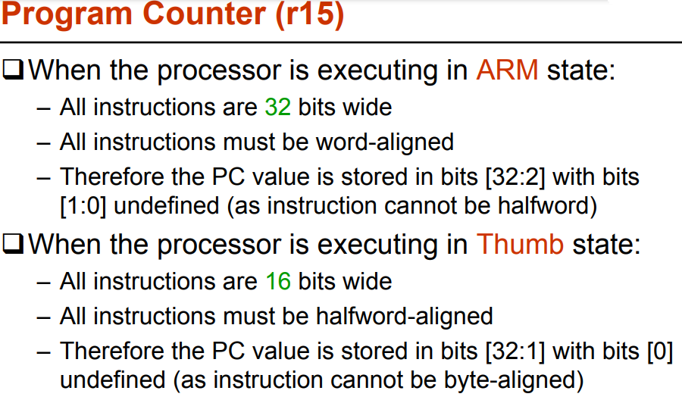

Slide 11
Program Status Register
Control Field
31
28
27
24
23
16
15
8
7
6
5
4
0
N Z C V Q
U n d e f i n e d
I F T mode
M[4:0] | Mode
0b10000 | User
0b10001 | FIQ
0b10010 | IRQ
0b10011 | Supervisor
0b10111 | Abort
0b11011 | Undefined
0b11111 | System
ARM Registers
11

Slide 12
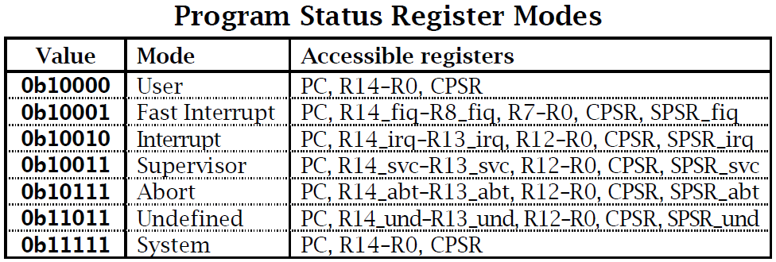

Slide 13
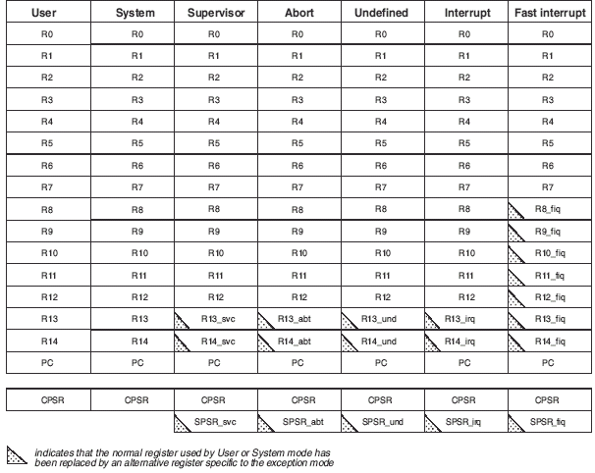
ARM Register Organization
R15
R15
R15
R15
R15
R15
R15
ARM Registers
13

Slide 14
ARM Register Set
ARM has total 37 Registers, 32 bits each
Program Counter - 1
Current Program Status Register (CPSR) - 1
Saved Program Status Register (SPSR) - 5
General Purpose Registers - 30
R0-R12, R13 (SP), R14 (LR), Abort-R13,Abort-R14,
SCV-R13,SVC-R14, Abort-R13, Abort-R14,
IRQ-R13,IRQ-14,
FIQ-R8, FIQ-R9,FIQ-R10, FIQ-R11, FIQ-R12, FIQ-R13,FIQ-R14
ARM Registers
14

Slide 15
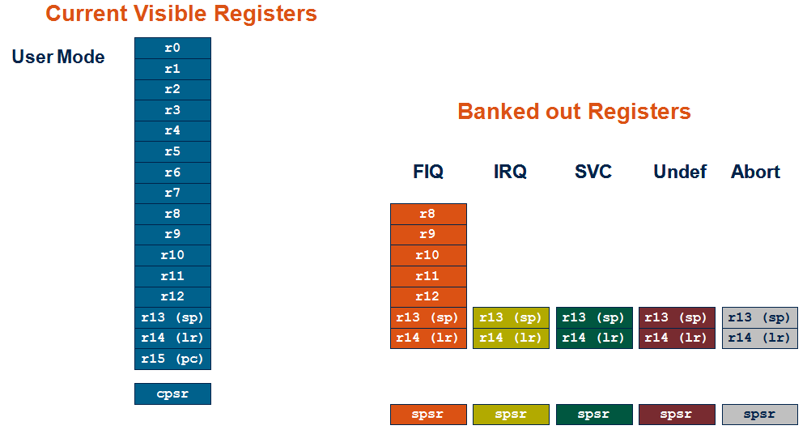
User Mode

Slide 16
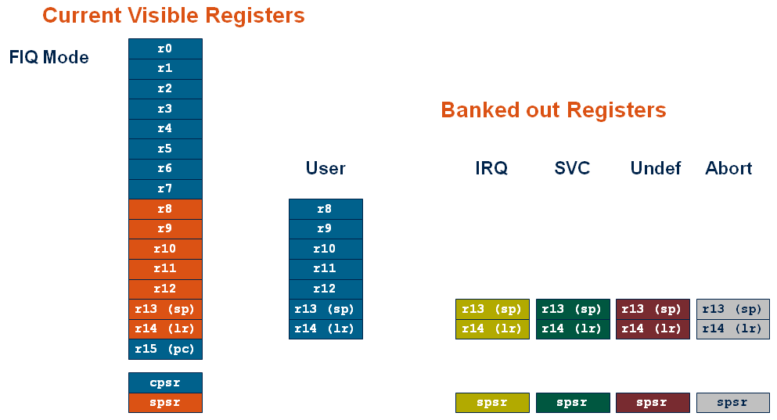
FIQ Mode

Slide 17
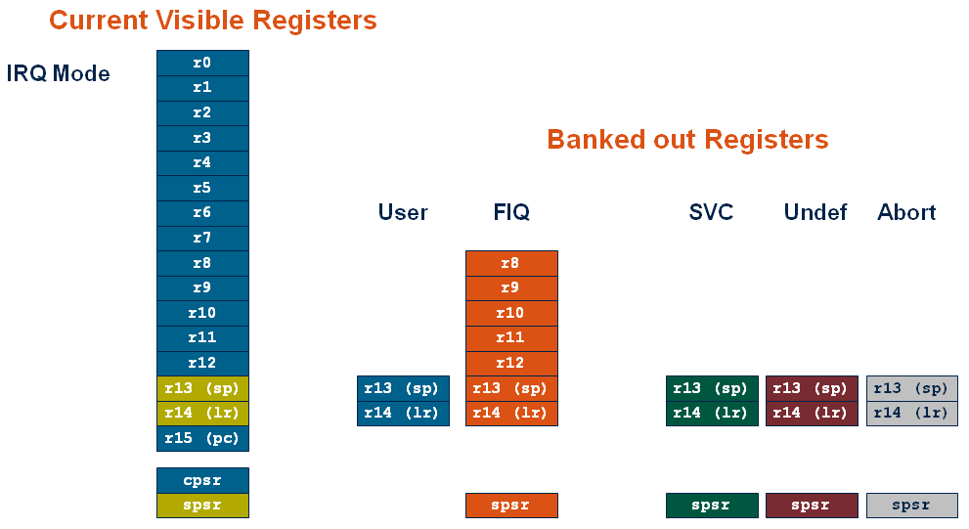
IRQ Mode

Slide 18
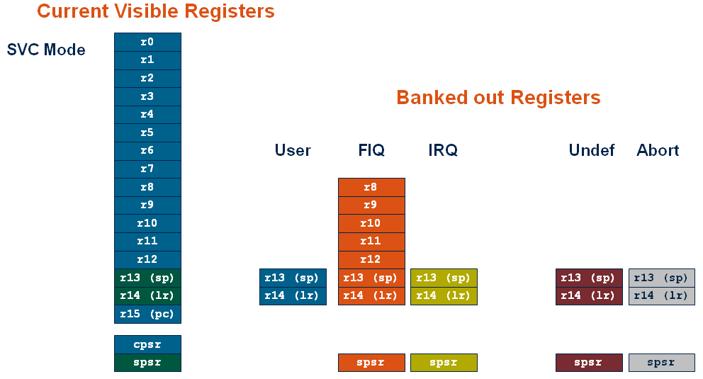
SVC Mode

Slide 19
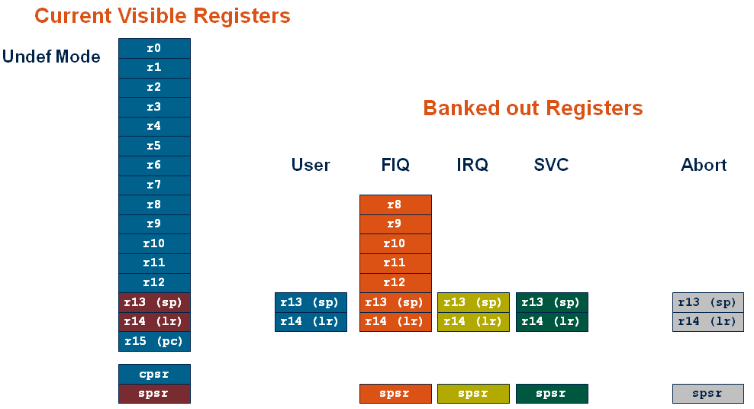
Undef Mode

Slide 20
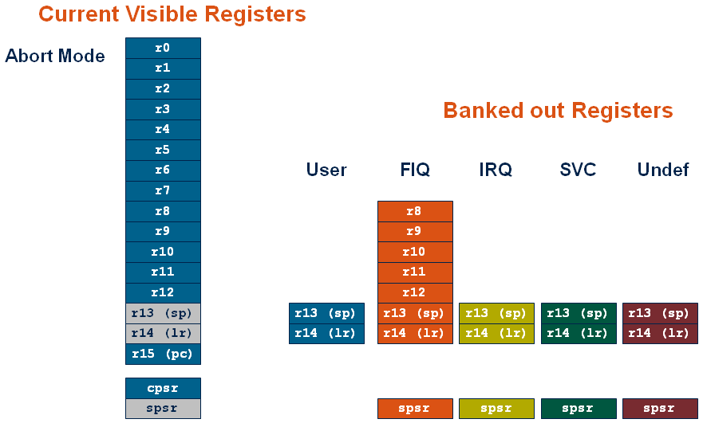
Abort Mode

Slide 21
Thank You
Thanks to Mr KP Peeyush and Dr KV Shriram

